Slide 1
Ms. Shruti A. Gadewar Ms. Kajal P. Raut Ms. Janhavi R. Naik Ms. Sakshi L. Patangrao
Babasaheb Naik College of Engineering,Pusad
Computer Science and Engineering
Project on
“Object Detection and Recognization”
Presented by
Guided by,
Prof. P.B.Pawar
H.O.D
Dr.S.S.Asole

Slide 2
Content
Introduction
Literature Survey
Problem Statement
Proposed System
OpenCV
Implementation
Applications
Result
Conclusion
References

Slide 3
Introduction
Object recognization
Object classification
Object localization
Object detection
Applications and recent technologies

Slide 4
Literature Survey
Fast R-CNN
Faster R-CNN
Region-based Convolutional Neural Networks (R-CNN)
Single Shot Detector (SSD)
YOLO (You Only Look Once)

Slide 5
Fast R-CNN
Ross Girshick
ConvNet forward pass for each region
Role of Fast R-CNN

Slide 6
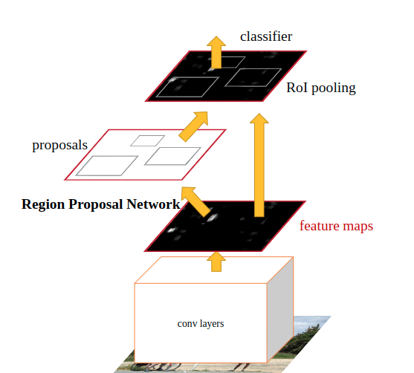
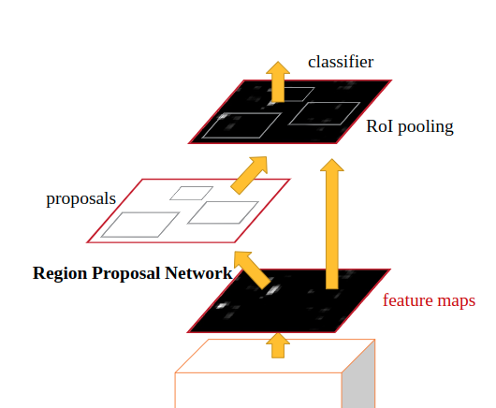
Faster R-CNN
Faster R-CNN (RPN + Fast R-CNN)

Slide 7
Region-based Convolutional Neural Networks (R-CNN)
R-CNN detector consists of four modules.
category-independent region proposals
extracts a fixed-length feature
class-specific linear SVMs
a bounding-box regressor
Single Shot Detector (SSD)
By using SSD, we only need to take one single shot to detect multiple objects within the image

Slide 8
YOLO (You Only Look Once)
This is an algorithm that detects and recognizes various objects in a picture (in real-time). Object detection in YOLO is done as a regression problem and provides the class probabilities of the detected images.

Slide 9
Problem Statement
problem of localization plus classification
Object detection
The important difference is the "variable" part.

Slide 10
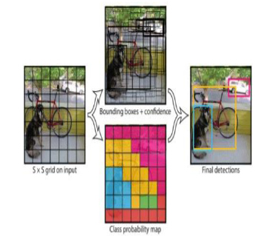
Proposed System

Slide 11
OpenCV
library of programming functions
OpenCV contains various tools to solve computer vision problems.
Object Tracking:
process of locating a object
wide range of applications

Slide 12
Edge Detection System
Gradient computation
Non maximum suppression
Double Thresholding
Edge tracking by hysteresis

Slide 13
Working of YOLO Algorithm
Residual Block
Bounding Box Regression
Intersection over Union(IoU)

Slide 14
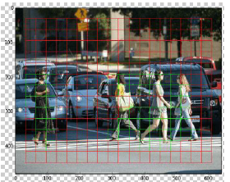
Residual Block

Slide 15
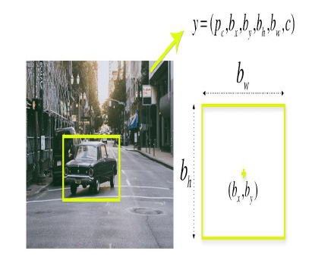
Bounding Box Regression

Slide 16
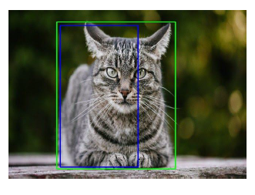
Intersection over Union(IoU)

Slide 17
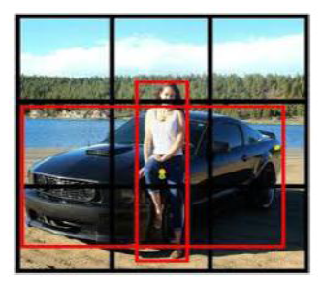
Anchor Box
Purpose
Example

Slide 18
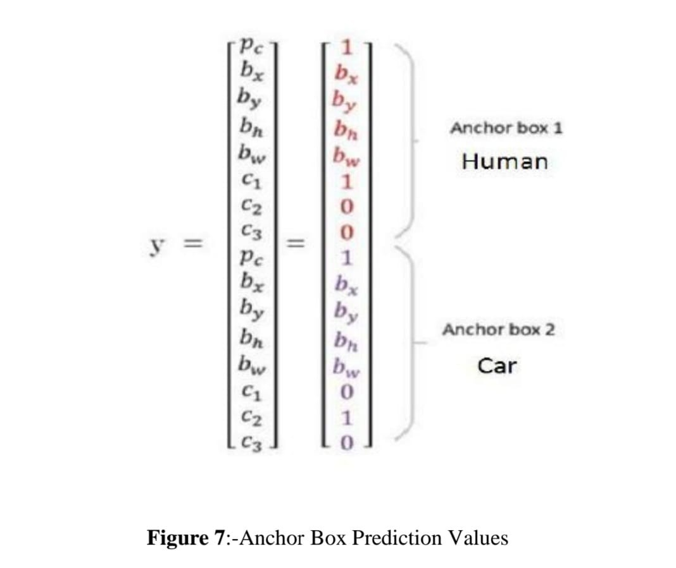

Slide 19
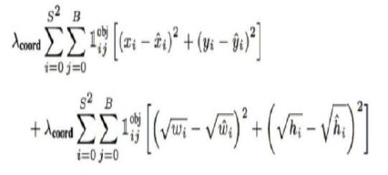
Result and Analysis
Loss Function of YOLO Algorithm
- Classification Loss Function
- Localization Loss Function

Slide 20


- Confidence Loss Function
Equation 1:-
Equation 2:-

Slide 21
Applications
Self driving car
Retail stores
Face Recognition
Medical diagnosis
Emotion Estimation

Slide 22
Conclusion
This algorithm is generalized.
The algorithm is simple to build and can be trained directly on a complete image.
Region proposal strategies limit the classifier to a particular region. YOLO accesses to the entire image in predicting boundaries.
Predicts fewer false positives in background areas.
More efficient and fastest algorithm to use in real time.

Slide 23
References
Geethapriya. S, N. Duraimurugan, S.P. Chokkalingam “Real-Time Object Detection with Yolo”, International Journal of Engineering and Advanced Technology (IJEAT) ISSN: 2249 – 8958, Volume-8, Issue-3S, February 2019
Joseph Redmon, Santosh Divvala, Ross Girshick, “You Only Look Once: Unified, Real-Time Object Detection”,The IEEE Conference on Computer Vision and Pattern Recognition (CVPR), 2016, pp. 779-788.
YOLO Juan Du1,”Understanding of Object Detection Based on CNN Family”,New Research, and Development Center of Hisense, Qingdao 266071, China.
Matthew B. Blaschko Christoph H. Lampert, “Learning to Localize Objects with Structured Output Regression”, Published in Computer Vision – ECCV 2008 pp 2-15.
5.https://www.section.io/engineering-education/introduction-to-yolo-algorithm-for-object-detection/

